Slide 1
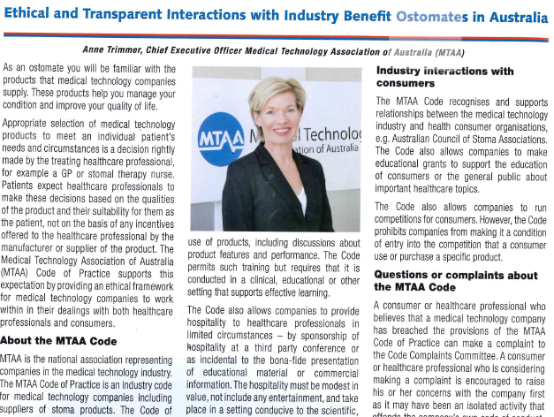
Sample Article
Courtesy of the Medical Technology Association of Australia

