Slide 1

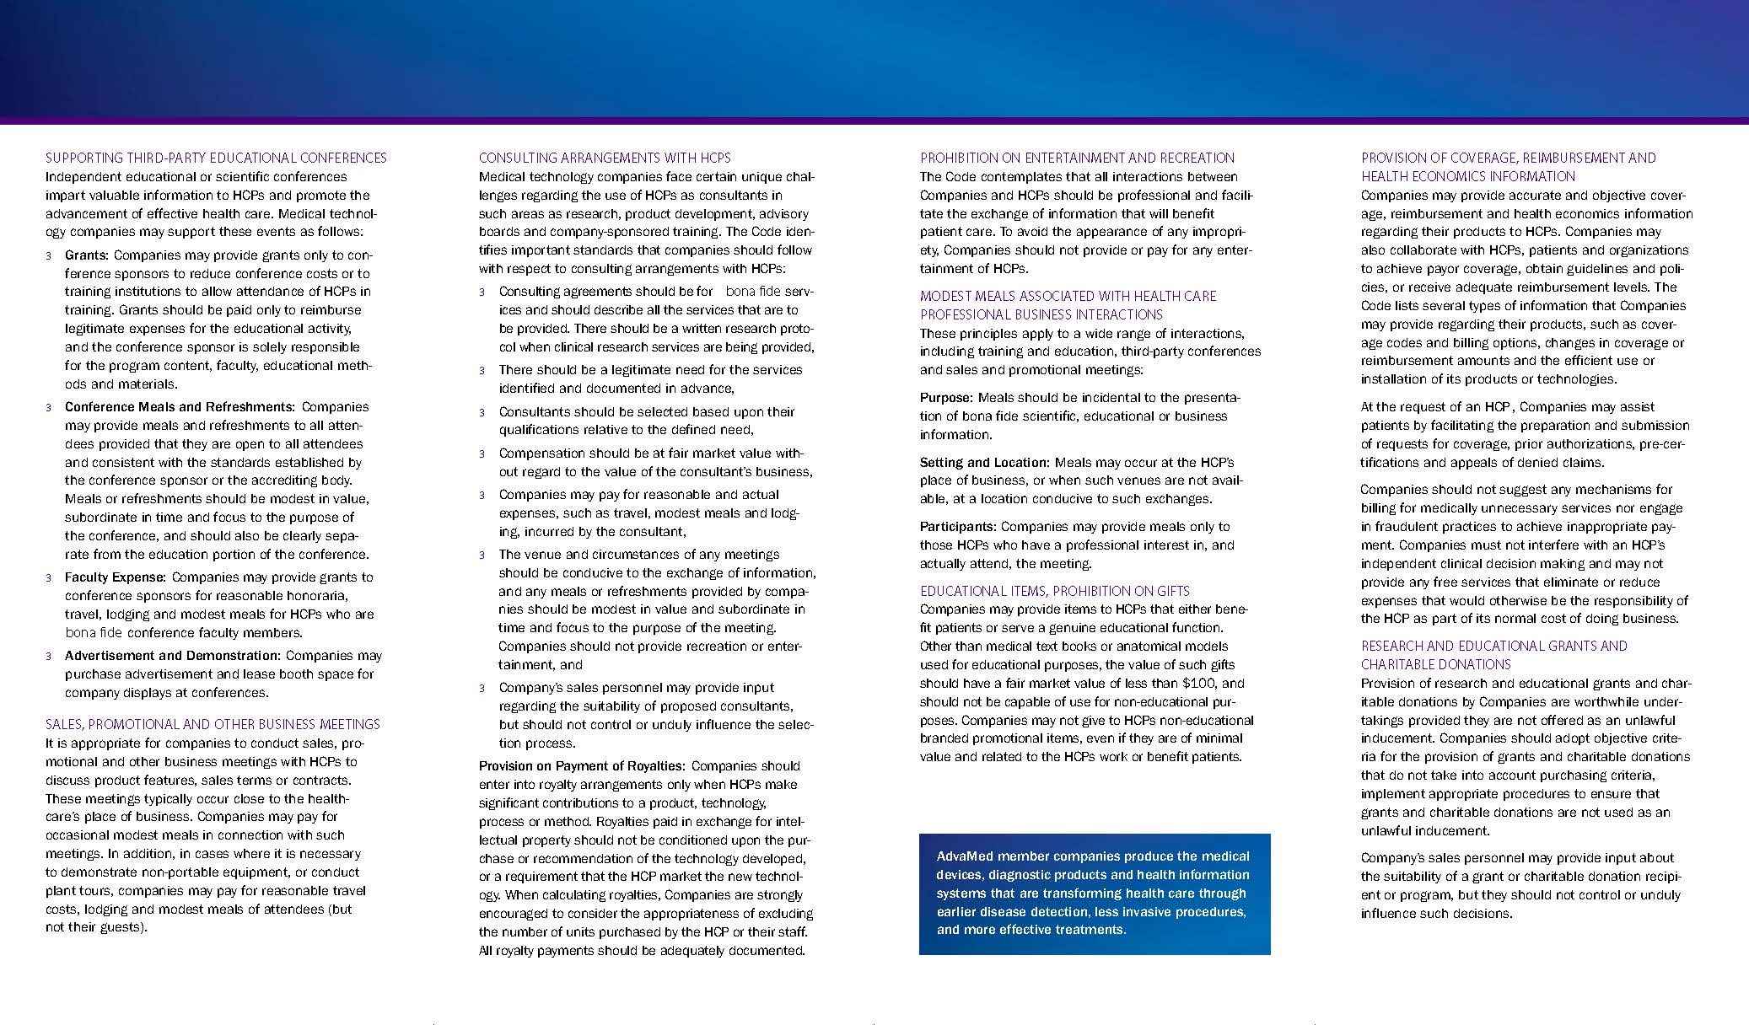
Sample Brochure on the Code of Practice for HCPs
Courtesy of the Advanced Medical Technology Association
Notes:
Develop a brief summary of your ethical requirements and distribute it widely .
AdvaMed’s most popular Code publication is the brochure, which is intended to be distributed to HCPs. This ensures that both company representatives and HCPs are clear about company responsibilities and obligations under the Code of Practice. This summary helps drive awareness of the Code, and ensures that its key principles are rolled out consistently.
The brochure summarises key sections of the Code that affect the way companies interact with HCPs. A company representative can use the brochure as an aid when communicating the key issues. The Association authors this content, ensuring it is consistent with the full text of the Code and emphasizes its most important points.

