Slide 1
Approach to Conformity Assessment for Medical Devices – The Industry
Perspective
Fatemeh Razjouyan
Director, Regulatory Policy, International and Harmonization

Slide 2
Regulators and manufacturers are committed to timely patient access to safe, effective, and quality medical devices

Slide 3
Conformity assessment is a critical mechanism in the medical device ecosystem
Medical devices are:
Safe
Perform as intended
Conform to the Essential Principles of Safety and Performance for Medical Devices

Slide 4
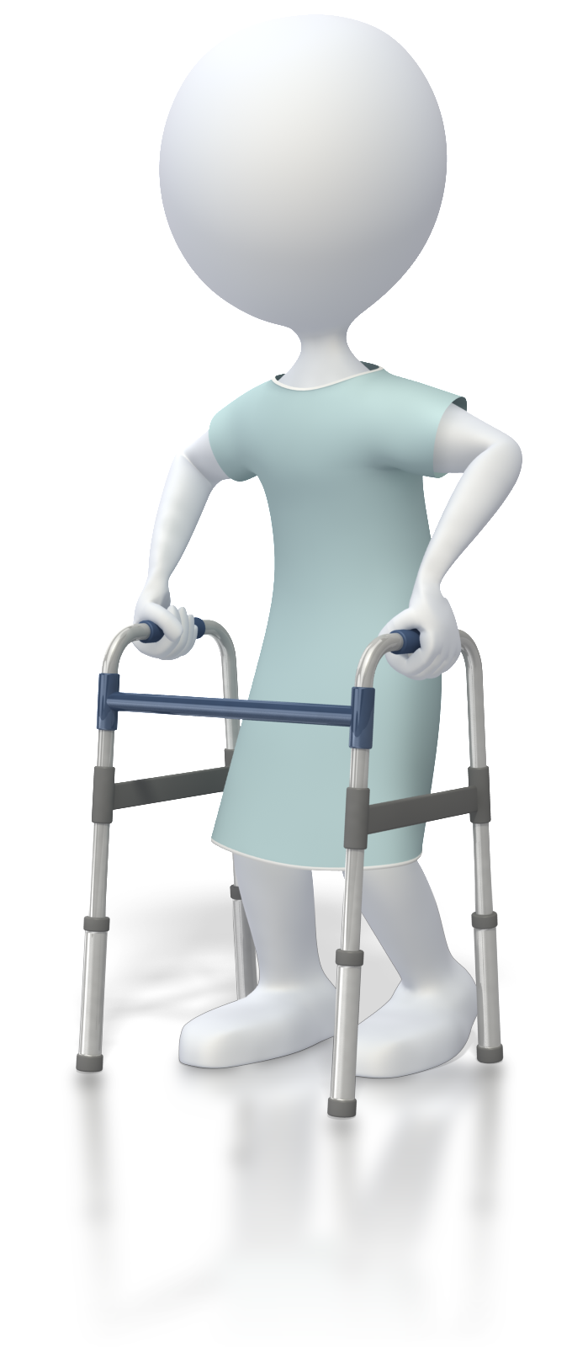
Lack of common regulatory framework and regulators’ resource challenges hinder patient access and manufacturers’ ability to introduce innovative and life-saving medical devices to market

Slide 5
Without regulators ability to perform, patient access to lifesaving medical devices will be highly impacted
~75%
One study revealed that, “[a]bout 75% of regulatory authorities are unable to perform all core functions consistently well and depend often on better resourced authorities.^{”1}
Lack of regulatory capacity, “[h]ampers efforts to ensure the quality, efficacy and safety of health products.”²
These constraints become even more visible during a public health emergency and have a direct adverse effect on patient access to potentially lifesaving medical treatments and diagnostics
Global regulatory agility during covid-19 and other health emergencies; Enhanced collaboration among authorities is key to ensuring timely access to high quality health products worldwide. Accessed April 3, 2021.
Roadmap for access to medicines, vaccines, and other medical products. 2019-2023. Accessed May 9, 2021.

Slide 6
This presentation covers:
Application of Reliance to conformity assessment
Benefits of a globally harmonized approach
How Reliance can be applied to conformity assessment

Slide 7
Manufacturers already adhere to all elements of conformity assessment for placing medical devices on the market, but they vary among regions
A quality management system (QMS)
A system for postmarket surveillance
Technical documentation
A declaration of conformity
The registration of manufacturers and their medical devices

Slide 8
“The future of medical products regulation is in convergence/harmonization, collaboration, and networking based on Reliance and trust.”¹
Reliance is not a less stringent form of regulatory oversight or outsourcing of regulatory mandates, nor does it compromise independence ²
A decision to “regulate through reliance” is the hallmark of a modern and efficient regulatory authority ²
Reliance applies to the total product lifecycle (e.g., product approvals and inspections)
Azatyan, S., MD, PhD. WHO Good Reliance Practices guidelines to support regulatory decision making [Conference Presentation], https://www.interamericancoalition-medtech.org/regulatory-convergence/wp-content/uploads/sites/4/2021/08/OMS.pdf, slide 17.
Good Reliance Practices in the Regulation of Medical Products, Annex 10, https://www.wto.org/english/tratop_e/trips_e/techsymp_290621/gaspar_pres3.pdf.

Slide 9
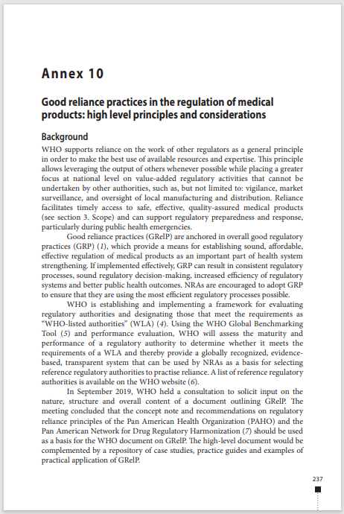
WHO supports Reliance among regulators to make the best use of available resources and expertise
WHO’s Good Reliance Practices (GReP) promotes a more efficient approach to regulation, thereby improving access to quality-assured, effective and safe medical products

Slide 10
A Globally Harmonized Approach Benefits All Stakeholders
1
Confidence in safety and quality of products
Innovative products – development and time to market
Access to life saving therapies in expedited manner
Patients
2
Quality of submissions and compliance
Supports innovation
Leverage resources
Collaboration
Efficiencies
Monitoring
Pandemic preparedness
Health Authorities
3
Promotes a transparent, efficient, and predictable regulatory environment
Supports innovation driven by patient needs
Reduces regulatory redundancy that pulls resources away from research & development
Decisions on where to market products
Industry

Slide 11
Examples of existing Reliance frameworks for devices
Medical Device Single Audit Program (MDSAP)
A single regulatory audit satisfies the requirements of multiple regulatory jurisdictions
Singapore’s Abridged Pathway
Applies to all classifications of products requiring regulator review and significantly reduces time to market
Shortens the review time from 310 days to 220 days for class D higher-risk products
Reduces the required information for review
Reference regulators include Australia, Canada, Europe, Japan, and the US
Australia TGA’s Reliance
TGA has relied on certifications from Notified Bodies and Health Canada Medical Device Active License Listing (“MDALL”) since 2010
In 2018, reliance was expanded to other regulators such as Japan and the U.S.
Singapore – Thailand Reliance Program
Initially piloted with only class D/class 4 products; is now open to all classes of medical devices
Reduces the review time to 60 days (the TFDA review times for class 2, 3, and 4 devices for standard applications can be up to a year)

Slide 12
How Reliance can be applied to conformity assessment to accelerate patient access to innovative and life-saving medical devices
1
Apply Reliance to total product life cycle
Leverages key regulatory decisions, such as inspection, premarket approval, and postmarket change approval performed by regulatory authorities, Notified Bodies, and recognized institutions
E.g., recognizing and fully relying on MDSAP and ISO 13485
2
Utilize and rely on internationally recognized consensus standards
Facilitates acceptance of testing to a collection of harmonized standards thus streamlining the conformity assessment process
3
Utilize the IMDRF recommendations
Facilitates Reliance by driving convergence (e.g., adopting IMDRF best practices, IMDRF essential principles of safety performance of medical devices and IVD)
4
Accept harmonized and electronic formats
One dossier format (e.g., eSTAR)
5
Minimize the need for country-specific clinical data
Directly accept clinical data that’s sufficiently diverse to eliminate duplication

Slide 13
In summary …
Application of Reliance to conformity assessment
“The future of medical products regulation is in convergence/harmonization, collaboration, and networking based on Reliance and trust.”¹
Benefits of a globally harmonized approach
Reliance will simplify and avoid unnecessary duplication of work throughout product lifecycle
This will result in faster access to innovative therapies and diagnostics to improve patient outcomes
How Reliance can be applied to conformity assessment
Utilize and rely on internationally recognized consensus standards, IMDRF recommendations, accept harmonized and electronic formats, and apply Reliance to total product lifecycle
Azatyan, S., MD, PhD. WHO Good Reliance Practices guidelines to support regulatory decision making [Conference Presentation], https://www.interamericancoalition-medtech.org/regulatory-convergence/wp-content/uploads/sites/4/2021/08/OMS.pdf, slide 17. .

